Slide 1

Data Insights and Presentation by Abdul Wahid

Slide 2

Introduction
In the given Sprocket Central data sheet, there are totally 20,000 transactions ids.
Each id is linked with different product id, list price and the standard price as well.
Profit from each transaction can be easily calculated by subtracting the standard price from list price, these can be used for data insights.
The presentation of the insights can be shown in the next slides.

Slide 3
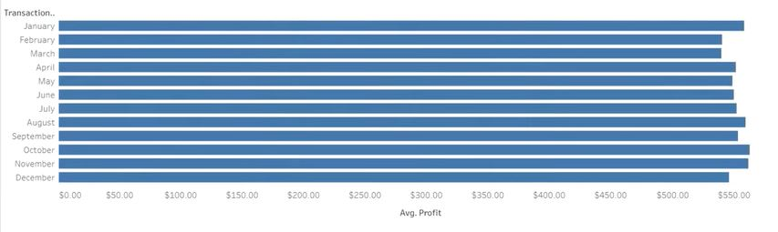
Transaction Month vs Average Profit

Slide 4
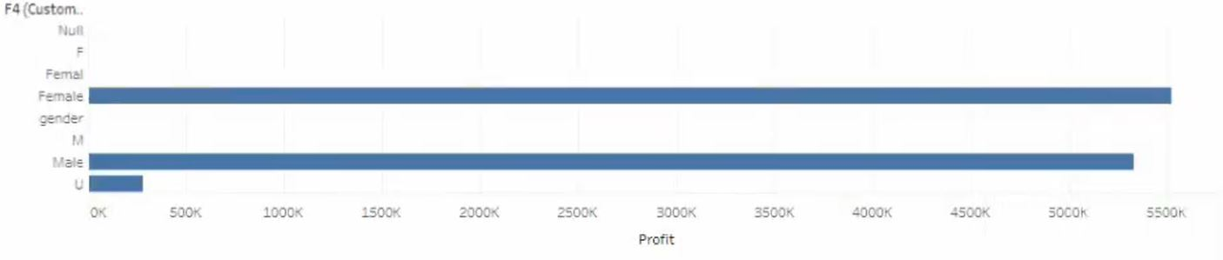
Gender vs Profit

Slide 5
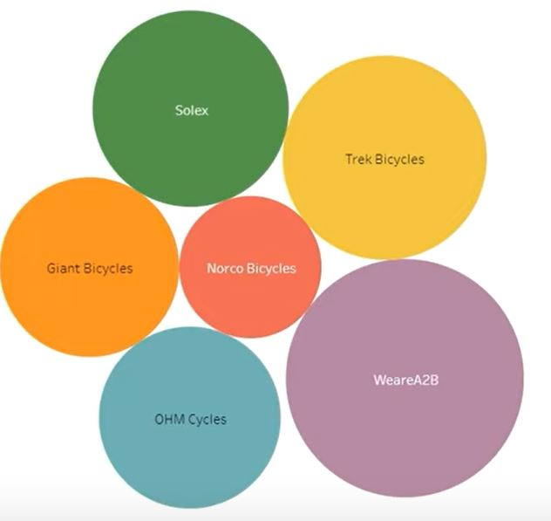
Brand vs Profit

Slide 6

Data Insights
All the graphs are created on Tableau software. The insights are mentioned below.
From Transaction Month vs Average Profit bar graph, transactions made in October has more average profit when compared to other months.
From Gender vs Profit bar plot, Female customers have received more profits than male
From Brand vs Profit graph representation, WeareA2B brand has got more profits than any other brands.

Slide 7

Thank You

